Slide 1
Client Side Scripting
Arrays

Slide 2
Arrays
An array is a special type of variable
An array is similar to a normal variable - you can use it to hold any type of data
But it doesn't just store one value; it stores a list of values
Collection of items

Slide 3
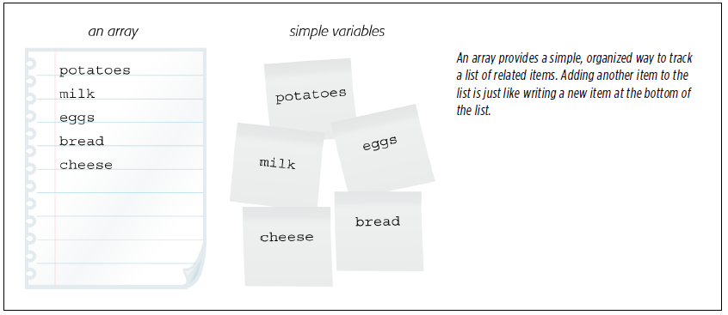
Arrays

Slide 4
Arrays
You should consider using an array whenever you are working with a list or a set of values that are related to each other
Arrays are helpful when you do not know how many items a list will contain
In JavaScript, you do not need to specify the array’s length when you declare it
A list could be used to store the different products in the shopping cart
The amount of list of products will always be different everytime the same/different user accesses the website to shop

Slide 5
Creating an Array Array Literal
In such a technique of creating arrays, the values are assigned to the array inside a pair of square brackets
Each value is separated by a comma
In JavaScript, the values in the array do not need to be the same data type, so you can store a string, a number and a Boolean all in the same array.

Slide 6
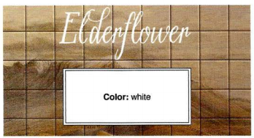
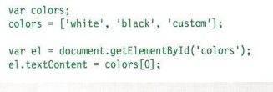
Creating an Array Array Literal

Slide 7
Creating an Array Array Constructor
This technique uses the new keyword followed by Array();
The values are then specified in parentheses (not square brackets)
Each value is separated by a comma
You can also use a method called item() to retrieve data from the array
The index number of the item is specified in the parentheses

Slide 8
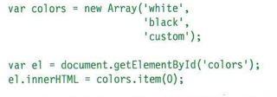
Creating an Array Array Constructor

Slide 9
Arrays
Values in an array are accessed as if they are in a numbered list
Each item in an array is automatically given a number called an index
This can be used to access specific items in the array
NB: The numbering of lists starts at 0 (not 1)

Slide 10
Accessing Arrays
You can access the contents of a simple variable just by using the variable’s name
alert(lastName)
The previous code opens an alert box with the value stored in the variable lastName
However, because an array can hold more than one value, you can’t just use its name alone to access the items it contains

Slide 11
Accessing Arrays
A number, index, indicates the position of each item in an array
To access a particular item in an array, you use that item’s index number
var days = ['Mon', 'Tues', 'Wed', 'Thurs', 'Fri', 'Sat', 'Sun'];
alert(days[0]);
Arrays are zero-indexed

Slide 12
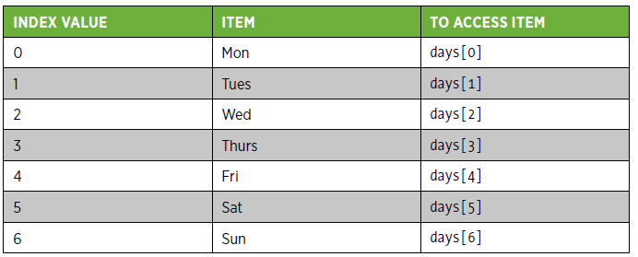
Accessing Arrays

Slide 13
Adding items to Arrays At the end of the Array
To add an item to the end of an array, you can use the index notation
Using an index value that’s one greater than the last item in the list. Example:
var properties = ['red', '14px', 'Arial'];
The last item is accessed using an index that’s one less than the total number of items
The last item in this array is
properties[2];

Slide 14
Adding items to Arrays At the end of the Array
To add another item:
properties[3] = 'bold';
This code inserts 'bold' into the fourth spot in the array, which creates an array with four elements:
['red', '14px', 'Arial', 'bold']
When you add the new item, you use an index value equal to the total number of elements currently in the array
To ensure this, you can use the array’s length property as the index
properties[properties.length] = 'bold';

Slide 15
Adding items to Arrays At the end of the Array
The array’s push() command can also be used to add whatever is passed between the parentheses to the end of the array
properties.push('bold');
One advantage of the push() command is that it lets you add more than one item to the array at once
properties.push('bold', 'italic', 'underlined');

Slide 16
Adding items to Arrays To the Beginning of the Array
If you want to add an item to the beginning of an array, use the unshift() command
var properties = ['red', '14px', 'Arial'];
properties.unshift('bold');
['bold', 'red', '14px', 'Arial']
As with push(), you can use unshift() to insert multiple items at the beginning of an array:
properties.unshift('bold', 'italic', 'underlined');

Slide 17
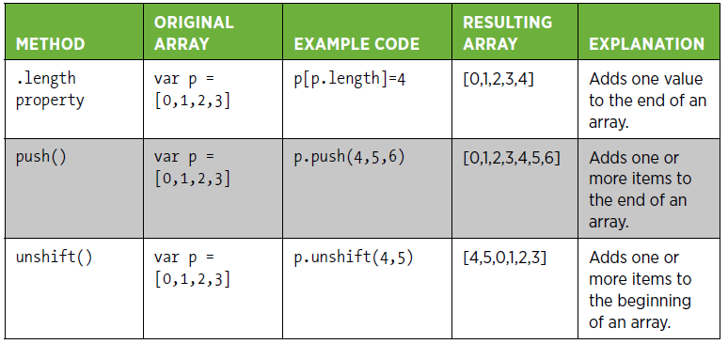
Adding items to Arrays

Slide 18
Deleting items from Arrays
If you want to remove an item from the end or beginning of an array, use the pop() or shift() commands
Both commands remove one item from the array:
pop() removes the item from the end of the array
shift() removes one item from the beginning of the array

Slide 19
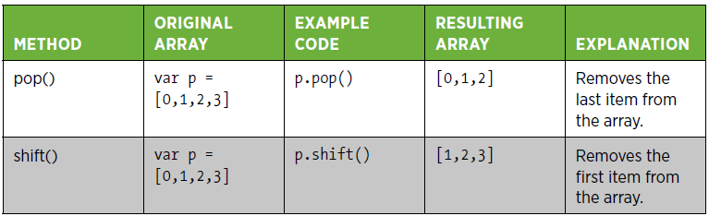
Deleting items from Arrays

Slide 20
Deleting items from Arrays
Once pop() and shift() remove the item from the array, they both return a value
They return the value that they have just removed So, for example, this code removes a value and stores that value in the variable removedItem:
var p = [0,1,2,3];
var removedItem = p.shift();
The value of removedItem after this code runs is 0 and the array p now contains [1,2,3]

Slide 21
Other Array Methods concat
Joins two or more arrays and returns a new array with all the items
var pizzaMeatParts = ['pepperoni', 'ham', 'bacon'];
var pizzaVegetableParts = ['pepper', 'onion'];
var pizzaParts = pizzaMeatParts.concat(pizzaVegetableParts);
pizzaParts is now made up of
[‘pepperoni’, ‘ham’, bacon’, ‘pepper’, ‘onion]

Slide 22
Other Array Methods indexOf
Locates the item in the array and returns its index, as shown in the following example, in which the baconIndex variable will be set to 2:
var pizzaMeatParts = ['pepperoni', 'ham', 'bacon'];
var baconIndex = pizzaMeatParts.indexOf('bacon');
baconIndex will contain 2

Slide 23
Other Array Methods join
Creates a string from the items in the array. The items are comma-delimited by default, but you can pass an alternate separator
var pizzaMeatParts = ['pepperoni', 'ham', 'bacon'];
var meatParts = pizzaMeatParts.join();
The above assigns a string containing ‘pepperoni, ham, bacon’ to the meatParts variable

Slide 24
Other Array Methods lastIndexOf
Searches from the end of the array for the last item in the array that meets the search criteria and returns its index:
var pizzaMeatParts = ['pepperoni', 'ham', 'bacon', 'ham', 'prosciutto']; var lastHamIndex = pizzaMeatParts.lastIndexOf('ham');
lastHamIndex variable will be set to 3

Slide 25
Other Array Methods reverse
Reverses the order of the items in an array and returns a reference (not a new array) to the reversed array, so the original array is modified
var pizzaMeatParts = ['pepperoni', 'ham', 'bacon', 'prosciutto']; pizzaMeatParts.reverse();

Slide 26
Other Array Methods slice
Returns a new array that represents part of the existing array
The slice method has two parameters:
start: the index of the first item to include in the result
end: the index of the item that you don’t want included in the result
var pizzaMeatParts = ['pepperoni', 'ham', 'bacon', 'meatball', 'prosciutto'];
var mySlice = pizzaMeatParts.slice(1,3);
mySlice variable will be assigned ‘ham’ and ‘bacon’
Note that ‘meatball’ is not included in the result, and the original array is not changed

Slide 27
Other Array Methods sort
Sorts the items in an array and returns a reference to the array
The original array is modified
var pizzaMeatParts = ['pepperoni', 'ham', 'bacon', 'meatball', 'prosciutto'];
pizzaMeatParts.sort();
pizzaMeatParts will contain ‘bacon’, ’ham’, ’meatball’, ’pepperoni’, ’prosciutto’:

Slide 28
Other Array Methods splice
Adds and removes items from an array and returns the removed items. The original array is modified
The splice method’s first parameter is the starting index of where to start adding or deleting
The second parameter indicates how many items to remove. If 0 is passed as the second parameter, no items are removed. If the second parameter is larger than the quantity of items available for removal, all items from the starting index to the end of the array are removed
After the first two parameters, you can specify as many items as you want to add
var pizzaMeatParts = ['pepperoni', 'ham', 'bacon', 'meatball', 'prosciutto'];
var mySlice = pizzaMeatParts.splice(1,2,'spam');
‘ham’ and ‘bacon’ are removed from the original array and assigns ‘ham’ and ‘bacon’ to mySlice
pizzaMeatParts now contains ‘pepperoni’, ‘spam’, ‘meatball’, ‘prosciutto’

Slide 29
Other Array Methods toString
All objects have a toString method
For the Array object, toString creates a string from the items in the array
The items are comma-delimited. If you want a different delimiter, you can use the join method and specify an alternate separator
var pizzaMeatParts = ['pepperoni', 'ham', 'bacon'];
var meatParts = pizzaMeatParts.toString();
meatParts now has a value of ‘pepperoni,ham,bacon’

Slide 30
Other Array Methods valueOf
All objects have a valueOf method
For the Array object, valueOf returns the primitive values of the array as a comma-delimited string
var pizzaMeatParts = ['pepperoni', 'ham', 'bacon'];
var meatParts = pizzaMeatParts.valueOf();
meatParts now has a value of ‘pepperoni,ham,bacon’

Slide 31
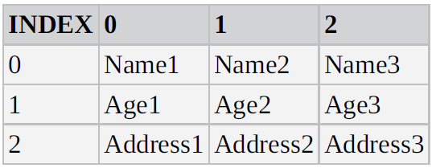
Multi-Dimensional Arrays
In a Single-Dimensional array, each element is specified by just one index—that is, one dimension.
A Multi-Dimensional array is one with two or more indexes for each element.

Slide 32
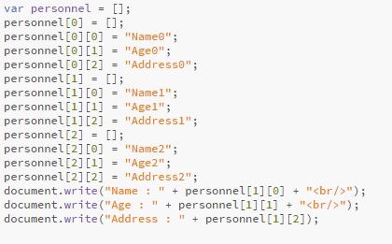
Multi-Dimensional Arrays
Since every row will be a new Array, in JavaScript we would need to indicate this:

Slide 33
Practice
Try out the previous example

Slide 34

Practice
Access Moodle and work out Worksheet 9

Slide 35
References
Johnson, G. (2013). Programming in HTML5 with Javascript and CSS3. United States of America: Microsoft Press.
McPeak, J. (2015). Beginning JavaScript, 5th Edition (5 ed.). Wrox.
Haverbeke, M. (2011). Eloquent JavaScript: A Modern Introduction to Programming. (S. Yang, Ed.) San Francisco: William Pollock.
McFarland, D. S. (2014). JavaScript & jQuery (3 ed.). United States of America: O’Reilly Media, Inc.
Duckett, J. (2014). JavaScript and JQuery Interactive Front-End Web Development (1 ed.). Wiley.

